Slide 1

MATERNAL HEALTH RISKS ANALYSIS

Slide 2
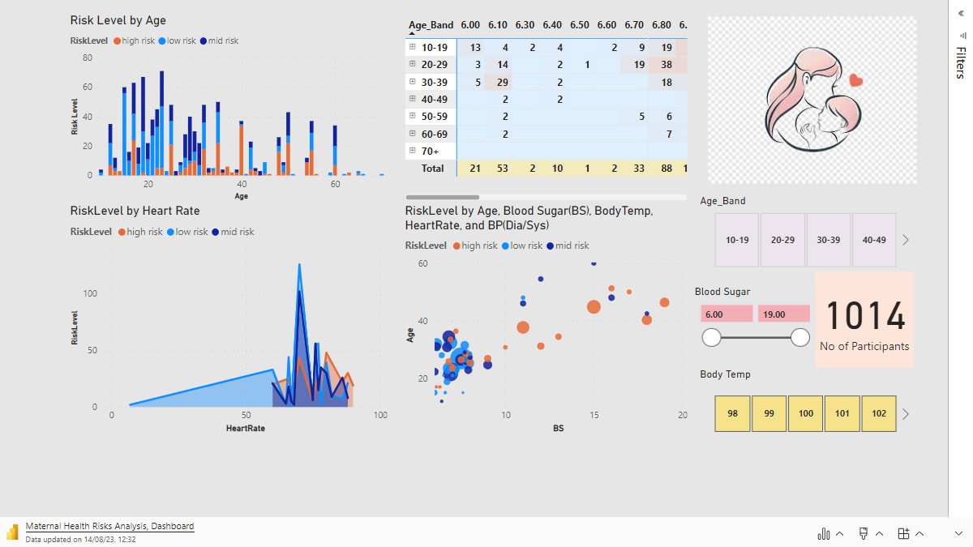

Slide 3
The primary objective of the analysis was to comprehensively evaluate potential health risks faced by pregnant women based on critical factors, including age, blood pressure (both systolic and diastolic), blood glucose levels, resting heart rate, and the predictive risk intensity level.
The key findings revealed a consistent pattern where risk levels exhibited a positive correlation with advancing age, particularly evident in attributes such as body temperature, heart rate, and blood glucose levels. Notably, a decline in blood sugar levels occurred after the age of 45, while specific age ranges, such as individuals aged 35-40, exhibited distinct increases in systolic blood pressure, and those aged 32-36 demonstrated higher diastolic blood pressure.
Recommendation:
Regular monitoring of blood pressure, particularly among individuals with elevated risk levels. Moreover, a tailored approach to managing blood sugar levels according to age-appropriate guidelines is crucial for individuals exhibiting increased blood sugar levels and associated risk factors.
Additionally, due attention should be directed toward temperature monitoring and educational initiatives, specifically targeting the observed rise in body temperature among individuals aged 20-40. Further investigation is essential to ascertain the underlying causes of this as can arise from multiple factors such as infections, hormonal fluctuations, or inflammatory responses.
Recognizing the increasing risk levels in heart rate with advancing age underscores the importance of emphasizing cardiovascular health. Encouraging routine cardiovascular health assessments and adopting heart-healthy practices, including regular exercise, balanced diets, and stress management, is crucial for maintaining optimal well-being.
Collaboration with healthcare professionals is importance in translating these findings into customized and effective care plans that account for the medical history and unique risk factors of each pregnant woman for a proactive health management.

